Slide 1
CONTROLS OVERVIEW

Slide 2
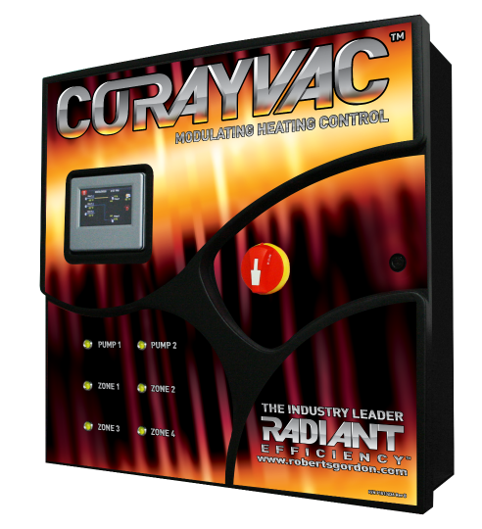
VALUE PROPOSITION
Energy efficient way to provide the precise amount of heat, when and where it is needed.
Notes:
Before we get into the weeds, let’s start with what’s the one main reason, the big thing, why customers should buy our controls over others?
This one main reason or big thing is referred to as a Value Proposition.
The Value Proposition or Unique Selling Proposition is a concise statement explaining why customers buy a certain product over others; what sets a product apart from the competition; what we offer that no one else does.
Our USP is (read statement).
This USP is supported by several facts; the main one being:
RG is the ONLY IR heating manufacturer that modulates based on outside temperature.
So that’s what sets us apart from the competition.

Slide 3
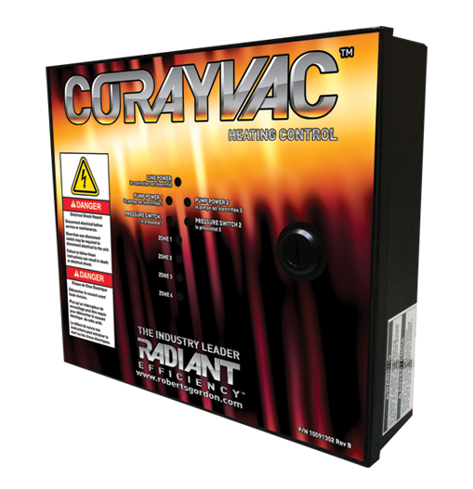
CONTROLS INTRODUCTION
Notes:
Now, let’s look at our controls offering and associated features/benefits.

Slide 4
ROBERTS GORDON® HEATING CONTROL OFFERING
Three (3) options:
CORAYVAC® Modulating Heating Control
Any combination of unitary (except two-stage) or modulating CORAYVAC®
VFD in panel
CORAYVAC® Heating Control
On/off multi-burner or on/off CORAYVAC®
COMPLETE™ Modulating Heating Control
Any combination of on/off single stage unitary, modulating unitary, on/off multi-burner or on/off CORAYVAC®
No VFD in panel
Notes:
The modulating controls are both microprocessor-based and modulate on outside air temperature.
Measure outdoor air temperature to match system input to building heat loss.
The CRV one allows any combination of:
On/off single stage unitary
Modulating unitary, so Vantage modulating
Modulating CRV
The Complete one allows any combination of:
On/off single stage unitary
Modulating unitary, so Vantage modulating
On/off multi-burner or on/off CRV
So, they both allow:
Single stage unitary
Modulating unitary, so Vantage modulating
The difference between the 2 is that the CRV one allows modulating CRV, the complete one allows on/off multiburner or on/off CRV.
CRV modulating has a VFD inside the control, the Complete does not.
The CRV heating control is for on/off multiburner or on/off CRV.

Slide 5
MODULATING HEATING CONTROL BENEFITS
Flexibility
Up to two (2) systems/four (4) zones – each panel
Stand-alone operation
Easy-to-use touchscreen
Central controller controls up to 31 satellite controllers
Compatible-BMS
Convenience
Ease of connection, service and programming
Notes:
Let’s talk about the features/benefits of both modulating controls.
Design flexibility
Up to 2 CRV systems, 4 zones (per panel)-combination of unitary & CRV
capable of controlling one CORAYVAC system with four zones of , or 1 CORAYVAC System with the other 3 zones to be used for any combination of unitary heaters.
capable of controlling two CORAYVAC systems with four zones of, or two CORAYVAC Systems with the other two zones to be used for any combination of unitary heaters.
on/off-all non-CRV models
Design limitations:
CRV modulating-can’t use on B-2 or B-4, min radiant pipe length & 1.5-2 ft/flow unit of tailpipe OR rec radiant pipe length & 1.2-1.5 ft/flow unit of tailpipe.
We don’t have a controller for 2-stage
Touch screen enables stand-alone operation providing a simple, convenient way to manage heating systems
central control panel will incorporate the touch screen which is used to program all of the satellite panels networked together.
From 1 touchscreen, from 1 central point, you can manage your system.
1 central can control up to 31 satellites.
4.3” color LCD display
Temp sensor
Humidity sensor
Integrates with BMS
Can connect to BMS using 8 leading protocols using BACnet, Modbus, N2, LonWorks.
Built in BACnet/IP connection capabilities
VFD located inside the panel, for easy programing, troubleshooting and servicing (CRV Modulating Control Only)
VFD can be selected to control one EP-203 and one EP-303 vacuum pump, but the VFD input power must be the same.
Single point connection for burners, VFD power, panel power and vacuum pump motor.
User interface allows for:
Ease of programing for the local user by choosing the preprogrammed screens.
Local monitoring for the maintenance manager .
Adjust set points with the simple touch of a button.
Custom graphics display for the end user.
Different screen level access based on different levels of security. Security based on who is interacting - users, end user, technician, engineer, etc.

Slide 6
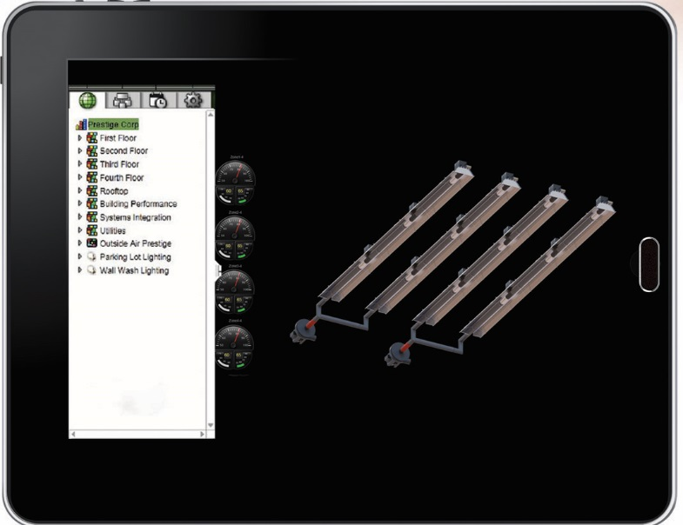
MODULATING HEATING CONTROL BENEFITS
WebCtrl BMS
Intuitive user interface
Powerful control features
On-site or remote off-site
Customizable
Secure
Easy, convenient
Notes:
Modulating Heating Control Options:
WEB Control (Web CTRL®) is an optional, web-based BMS
Offers intuitive user interface, powerful features to control:
Managing occupants’ comfort
Manage energy conservation efforts
Identify key operational problems
Analyze results
Your equipment can be accessed on site or remote off site to the central controller from anywhere in the world via a touchscreen, PC or smart device.
No need for special software plug-ins on the workstation or dedicated workstation.
Can be customized to the specific building providing users with a graphical representation showing facility status
Live interactive graphics showing equipment and building status
Secure, tamper-proof
Multi-level password protection for security
Unlimited, simultaneous users
Easy, convenient way to view indoor/outdoor temps, alter settings or program from anywhere
Setting and changing schedules
Adjusting set points
Advanced alarm management capabilities like email, text
Graphically trending building conditions, program schedules, etc.
Custom reports on energy usage, occupant overrides
Client computer requirements:
Dual core processor
1.4 GB RAM
Communications link of 10 Mbps (mega bits per second) or higher
64-bit processor

Slide 7
MODULATING HEATING CONTROL BENEFITS
Field Assistant
For start up & troubleshooting
Install on PC or laptop
Communicate via local access or over IP
Connectivity
Equipment Touch App (app version for Android)
Notes:
Field Assistant
Stand alone tool you install on a computer or laptop to access a single controller, several controllers or a network of controllers and routers.
Don’t need to be connected to internet
Optional package available FREE on rep portal
Communicate with devices using local access (10 or less controllers) or over an IP network to access entire network of routers and controllers
Can plug into any zone sensor and any controller and can access central controller
Used during initial set up or trouble shooting
Equipment touch app is $30
Allows direct connection to controller via Android phone or tablet
Upload parameters and source files (control programs, drivers, graphics, touchscreen files
Adjust setpoints and other control parameters
View trends
Set and change schedules
Run preconfigured reports

Slide 8
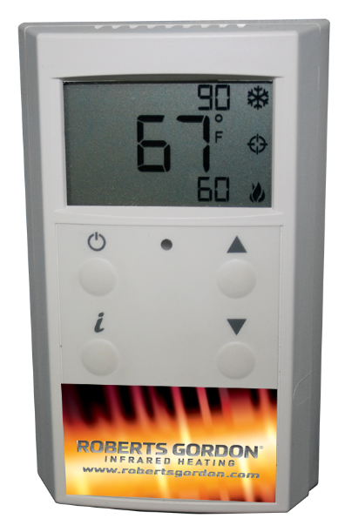
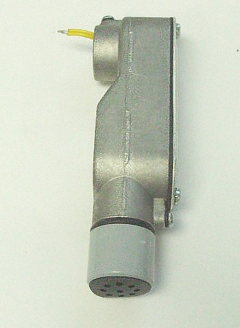
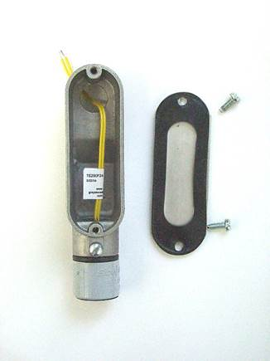
ROBERTS GORDON® SENSORS
Indoor zone sensor
Outdoor air sensor
Notes:
Indoor sensor:
Measures air temp in building
Locate within heated zone at occupant level.
1 sensor/zone, can do 2 sensors/zone
Mount on inside wall, away from air vents or other sources of heat and cold.
Don’t mount under 1st section of radiant, in direct sunlight or in path of other radiant heat to avoid short system cycles and inaccurate temp readings.
Large, easy-to-read LCD temp display
Setpoint display
Setpoint adjust
Occupancy status indicator
Push-button occupancy override
Info screen
Diagnostics screen
Addressable/supports daisy chaining
Alarm indicator
Outdoor sensor:
Measures air temp outside the building.
Locate on outside of building on north facing wall.
Locate high under an eve to prevent incorrect readings from direct sunlight and damage due to elements.
Mount with sensor module facing down to prevent accumulation of dirt or water.
Power for all sensors is from the ‘+12 V’ terminal on the Rnet port of the control board.
Max length of sensor daisy chain is 500’. Max distance from controller to any sensor is 500’.
Interactive Zone Sensors are available
The Zone sensor displays zone temperature and outside air temperature.
Occupancy override is easy using the “Manual On” momentary push button on the sensor. A single push switches the zone to an Occupied mode for a preset period of time. Multiple pushes increase the override time and the LCD displays precisely how long the zone will stay occupied.
The occupancy override time per push and maximum override time are fully adjustable.

Slide 9
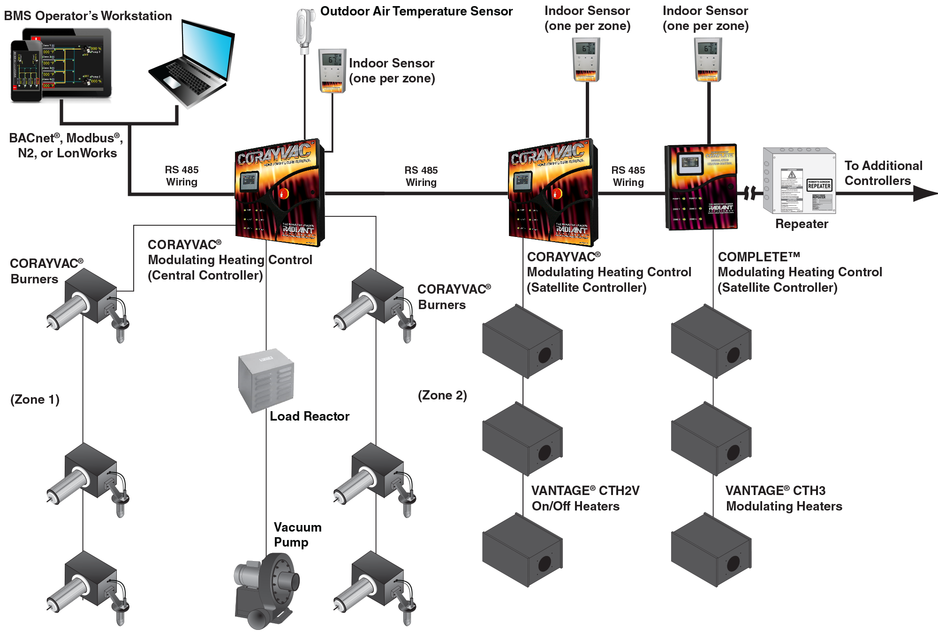
TYPICAL LAYOUT
Notes:
To give you an idea of how the various components (controls, burners, pumps, etc.) work, here’s an overall view of connected components.
Call out each part.
Central controller comes standard with touch screen and communicates with all satellite controllers and unitary controller, if applicable.
Repeaters required based on overall distance and baud rate. Jim’s going to get into detail later on that.
Load reactors required when distance from controller to vacuum pump is more than 100’.
Reference IOM.

Slide 10
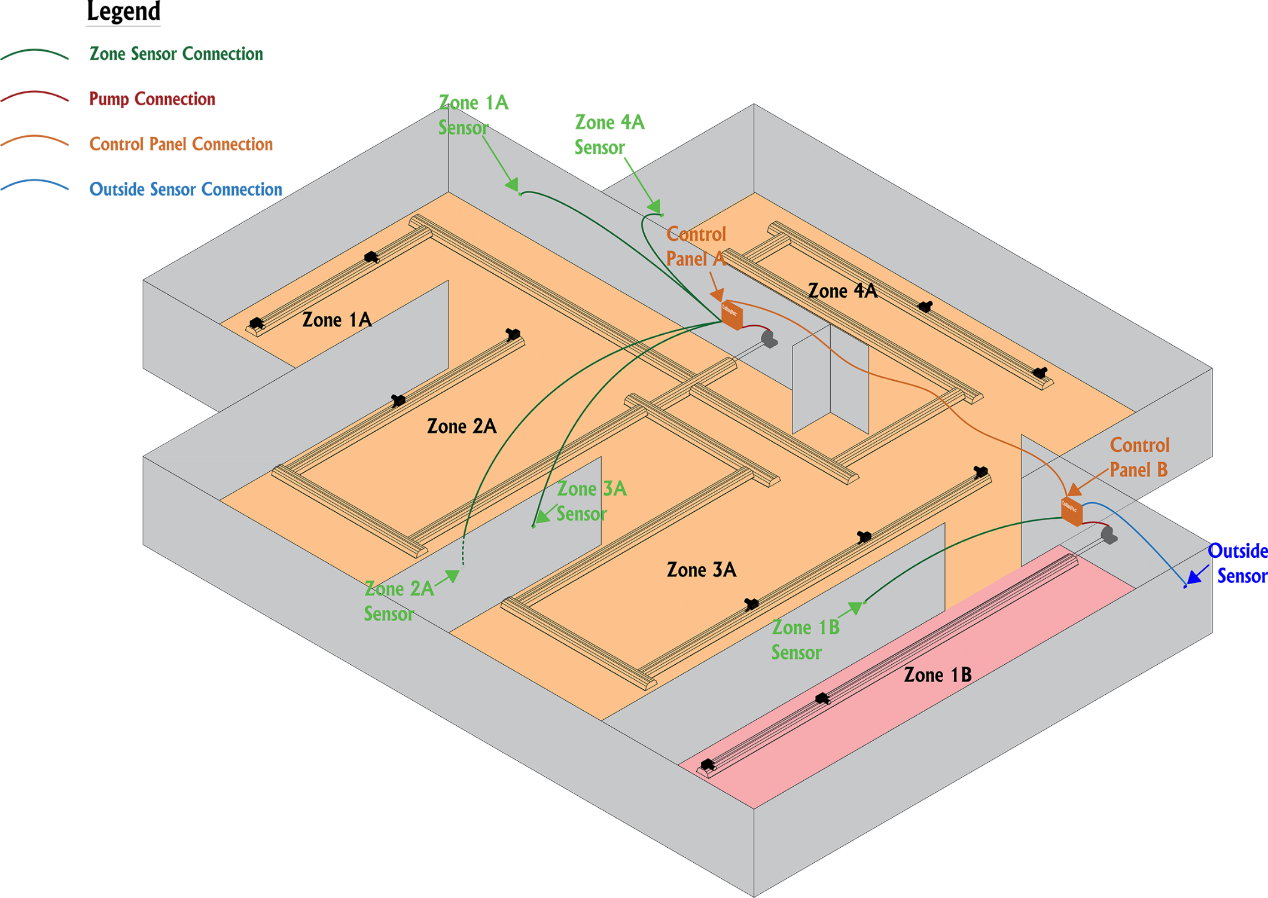
SITE LAYOUT
Notes:
Here’s a site layout consisting of 4 zones of CRV using the CRV Modulating Infrared Heating Control.
Call out each part.
Reference IOM.

Slide 11
CORAYVAC® HEATING CONTROL BENEFITS
Multi-function relay that responds to a thermostat
Simpler way to get zones-tie zone stats to controller
Notes:
For on/off multi-burner systems OR on/off CRV systems.
Simple way to control CRV via zone low voltage thermostats - 1 central location
Can do 2 systems/4 zones
No bacnet, no BMS
Ready to go from the box, programming not required
Panel indicator lights provide heating system operation status
NEMA 1 rated enclosure provides additional durability in dirty environments

Slide 12
IOM REFERENCES
Section 1 – controls’ descriptions
Section 1.12 – example site layout
Section 1.12 – connected components layout
Section 3.5 – sensor details
Section 5.1 – WebCTRL® details
Section 5.8 – Touchscreen details
Section 5.9 – Repeater installation
Section 12 – BMS integration

