Slide 1

REPEATER TROUBLESHOOTING

Slide 2
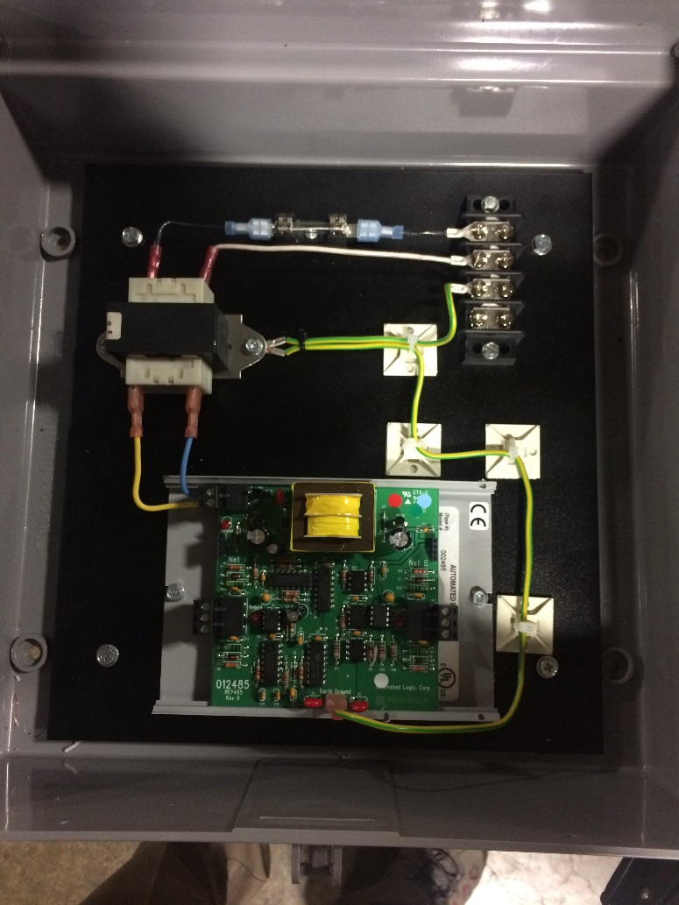
REPEATER TROUBLESHOOTING
• Is there a Repeater in RS-485 communication line?

Slide 3
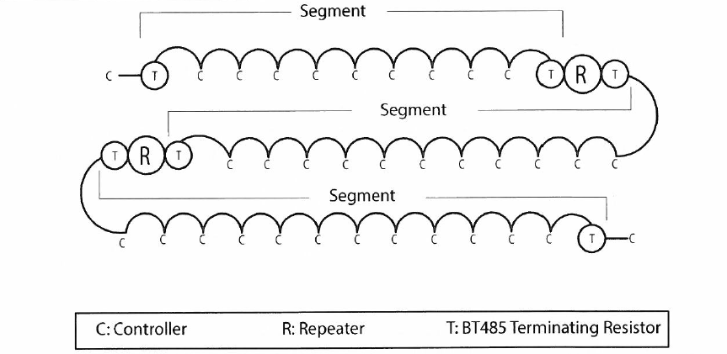
REPEATER TROUBLESHOOTING
• Sample network configuration using MS/TP

Slide 4
REPEATER TROUBLESHOOTING
• Can not have >4 repeaters in series

Slide 5
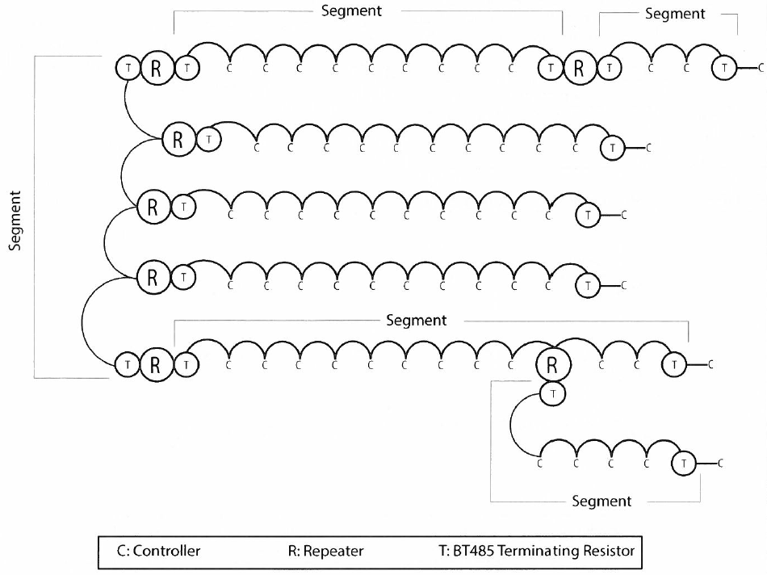
REPEATER TROUBLESHOOTING
• Hybrid configuration

Slide 6
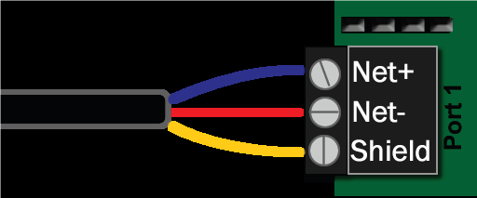
REPEATER TROUBLESHOOTING
• 24V power input
  • Receive and send data by looking at blinking LEDs

Slide 7
REPEATER TROUBLESHOOTING
• Check the 24v power
• Check cable specification

Slide 8
REPEATER TROUBLESHOOTING
• Check that all communication cable wires are connected “+” terminal to “+” terminal and “-“ terminal to “-“ terminal. Check that the device address on rotary switches is correctly set. Check that all drain wires are connected to a solid ground.

Slide 9
IOM UPDATES
Section 9 - Troubleshooting

