Slide 1

TOUCH PAD TROUBLESHOOTING

Slide 2
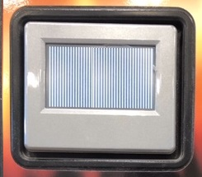
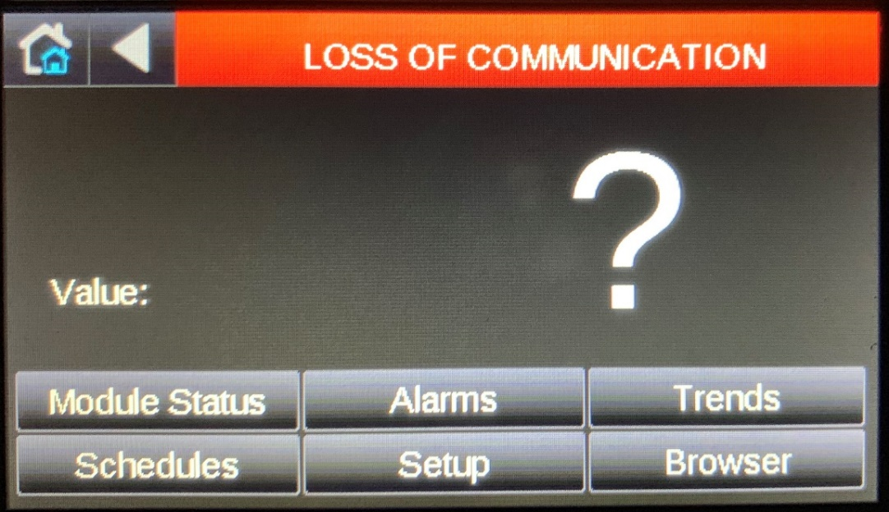
TOUCH PAD TROUBLESHOOTING
• Does touchscreen show vertical lines on screen?

Slide 3
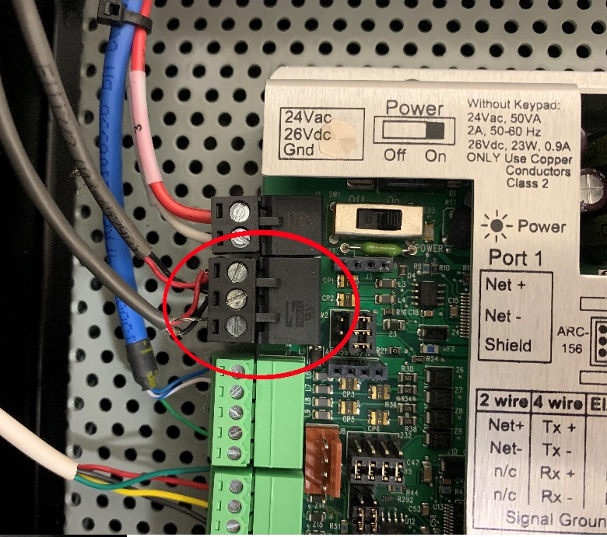
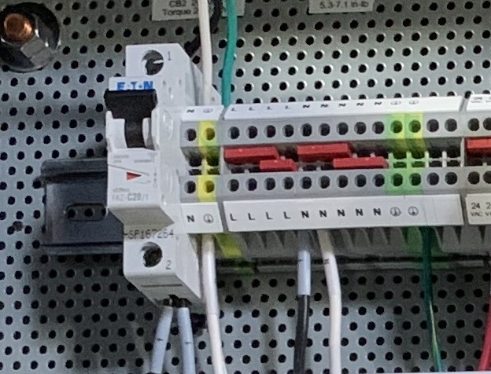
TOUCH PAD TROUBLESHOOTING
• Check MS/TP communication cable

Slide 4
IOM UPDATES
Section 9 - Troubleshooting

